Slide 1
Git – Working with others
AI2C Tech Intro
Jul 2026

Slide 2
Review:

Slide 3
Before we begin…
Let’s take a tour of GitHub…
Notes:
Have students pull up Github. Show them (in this order):
How to navigate to Repositories
How to navigate to settings --- > developer settings
How to navigate to settings --- > SSH/ PAT
How to navigate to settings of a specific repository
How to create a repository

Slide 4
Objectives:
Push changes to a remote repository from a local repository
Pull changes from the remote repository to the local repository
Discuss origins, forks, and upstreams

Slide 5
Remotes and origins:
Cloning – automatically sets up an “origin” remote URL tracking that repository
Fetch, pull, push all work on that “origin” repository
Can specify an alternate name or repository
git remote -v
git remote show origin
Why might I ever use multiple remotes?

Slide 6
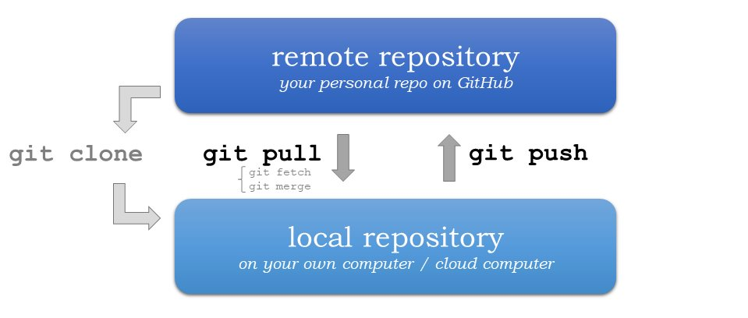
Pushing and pulling:
Meet Git

Slide 7
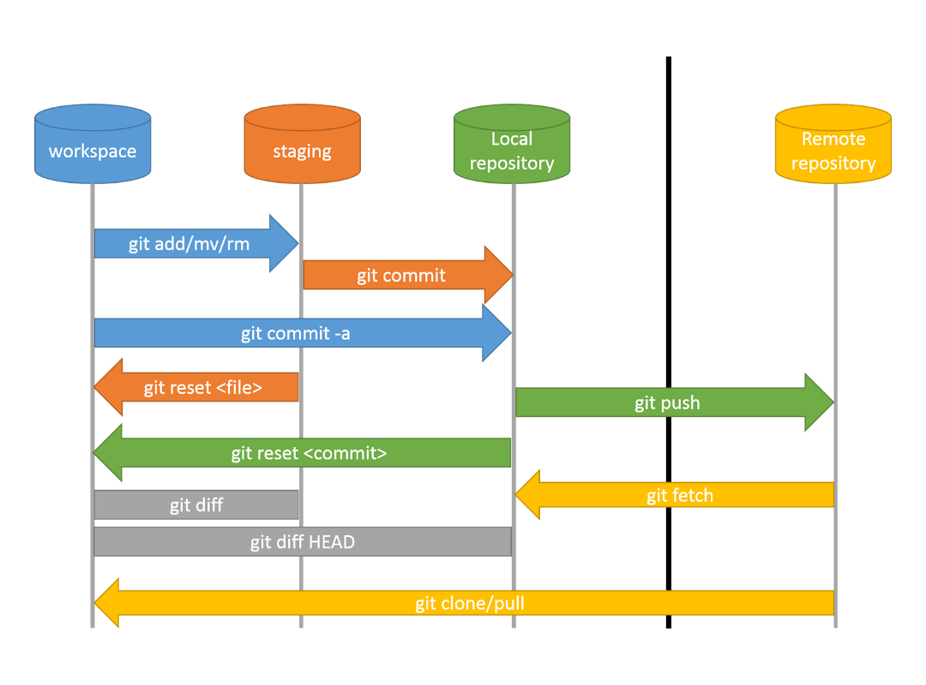
Git Pull:

Slide 8
Forking and upstreams:
Read this link to the “Prerequisites” section: https://docs.github.com/en/pull-requests/collaborating-with-pull-requests/working-with-forks/fork-a-repo
What is a fork? What uses does it have?

Slide 9
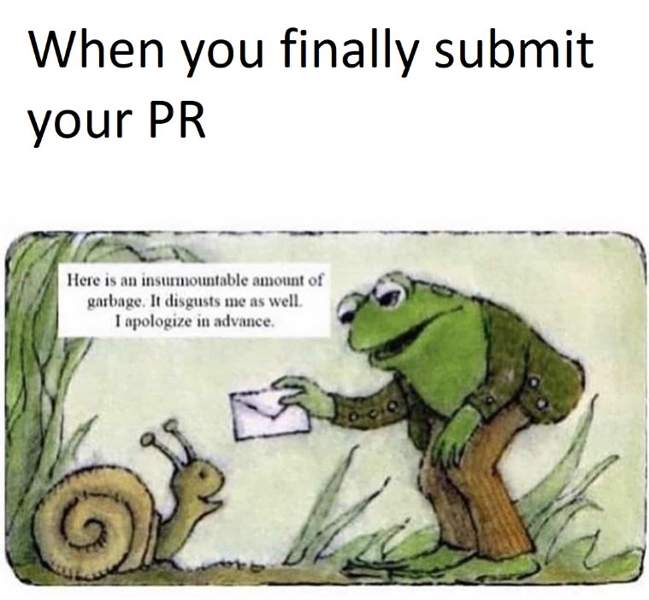
Pull requests
Should really be named a “merge” request.
“Would you please merge my changes into your repository?”
If forked, the original developers need to pull from your repository to do the merge

Slide 10
Hands-On #1 :
Create a remote repository
Push/pull from the remote repository
Notes:
Walk through creating a remote repository. Create a sample code file in the repository using GitHub.

Slide 11
Questions?

Slide 12
Hands-On #2 :
Create a local folder and then initialize it as a git repository
Add an arbitrary code file
Create a remote repository on GitHub
Push/pull from your local repository to the remote repository

Slide 13
Questions?

Slide 14
Hands-On #3 :
Create a remote repository and add an arbitrary file
Fork the repository
Clone the fork onto your local workspace
Create and commit arbitrary changes to the local repository
Create several changes (commits)
Push your changes to your fork
Issue a Pull Request back to the upstream

